Slide 1

Building Your Digital Forensic Workstation
A powerful digital forensic workstation forms the backbone of effective investigations. You'll need specific hardware to handle complex analysis tasks.
The right setup ensures you can process evidence efficiently and maintain case integrity.

Slide 2
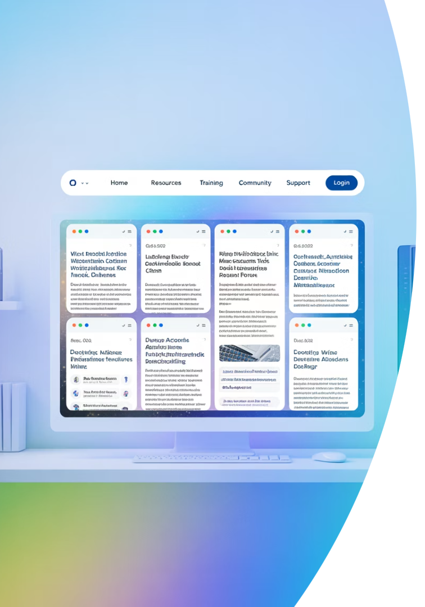




Essential Forensic Resource Links
Blue Cape Security
Comprehensive guides for forensic workstation setup and configuration.
Exterro Knowledge Base
Detailed hardware considerations and compatibility information.
SEARCH.org
Authoritative documentation on component specifications and standards.
ForensicFocus Forums
Community expertise for troubleshooting and advanced techniques.

Slide 3
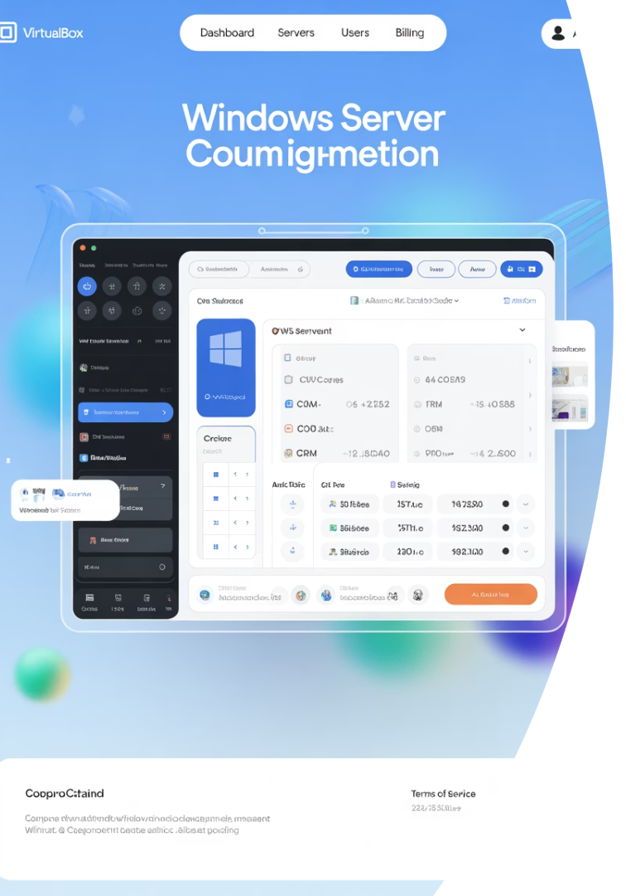




Virtual Machine Setup
Install Hypervisor
Download and install VirtualBox as your foundation.
Create Windows VM
Set up Windows Server 2019 Essentials as your base environment.
Allocate Resources
Assign at least 16GB RAM and 4+ CPU cores.
Configure Network
Set up isolated network access for secure analysis.

Slide 4








Essential Forensic Software Installation
Enable WSL
Open-Source Tools
Install Windows Subsystem for Linux with Ubuntu.
Install Autopsy, Volatility, and other core analysis tools.
Evidence Protection
Specialized Suites
Configure write-blockers and acquisition tools.
Add dedicated tools for specific investigation types.

